Slide 1
Welcome!
Question of the Day:
What is your favorite outdoor place in Austin?
MiniPlay goes here.
1

Slide 2
4.2 Cumulative Algorithms
4.3 Text Processing
4.4 Methods with Conditional Execution???
CAROL RAMSEY
GDC 6.318
ramsey@cs.utexas.edu

Slide 3
Announcements - Getting This Done!
If you didn’t get the grade you wanted on the Unit 1 Exam:
Meet with CS Academic Coach, Claudia Trevino
CS 312 Study Plan - This Friday Only
1 - 2, GDC 2.410
4 - 5, GDC 2.410
Attend Free Group Tutoring with Caleb each week.
Wednesday, 4 - 5:30, GDC 3.516
Thursday, 2 - 3:30, GDC 2.104
https://buddy312-9c200.web.app/#home

Slide 4
4.1 Quiz

Slide 5
Catch Up
4.1 Slides 37-39

Slide 6
4.2
Cumulative Algorithms
Notes:
Session Title: Project Based Learning (PBL) for Equity in CS classes
Session Description: If you are teaching a survey course like Computer Science Principles, or a code intensive course like AP CS A, PBL can serve as a powerful tool to increase student interest and engagement. Learn about research that connects PBL to improved student outcomes, especially for girls and underrepresented minorities. Discover available PBL resources and understand PBL lesson components, so you can build your own.

Slide 7
Conditions in a Sequence Patterns
Description | Pattern
Mutually exclusive, always 1 outcome Nested ifs with else | if (condition1) // code else if (condition2) // code else // code
Mutually exclusive, 0 or 1 result Nested ifs, no else | if (condition1) // code else if (condition2) // code
Not mutually exclusive independent ifs, no elses | if (condition1) // code if (condition2) // code if (condition 3) // code
Match these examples:
Whether you made the dean's list (GPA > 3.8) or honor roll (3.5-3.8).
Whether a number is divisible by 2, 3, and/or 5.
Assigning a letter grade A, B, C, D or F based on an average

Slide 8
Conditions with a return Patterns
Description | Pattern
Return within if statements - each possible path must return | if (condition1) // code return (answer + 1) else if (condition2) // code return (answer + 2) return (answer + 3)
Sometimes it’s better to return once at the end | answer += 3 if (condition1) // code answer -=2 else if (condition2) // code answer -=1 return (answer)

Slide 9
Demo
Demo1() and Demo2()
Common Errors

Slide 10
More on Logic Expressions
Relational operators cannot be "chained" as in algebra.
2 <= x <= 10 // x = 15
true <= 10
error!
Instead, combine multiple tests with && or ||
x >= 2 && x <= 10 // x = 15
true && false
false

Slide 11
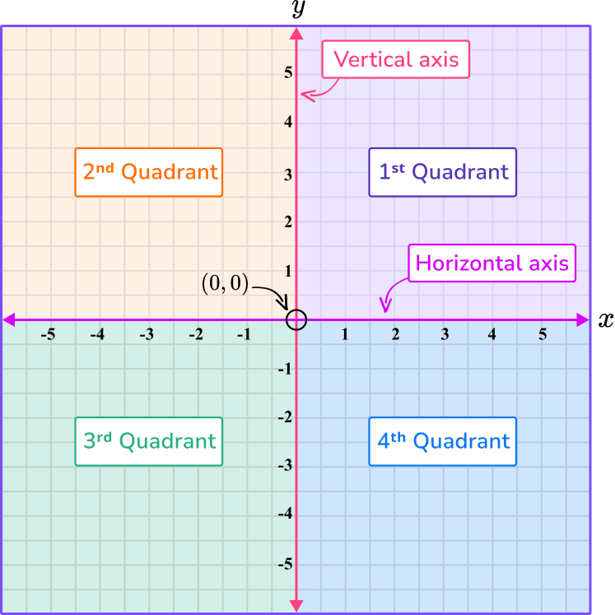
In-Class Practice
Write a method that accepts an x, y point on a coordinate grid and returns the quadrant of that point.
getQuad(4, -2) returns 4
getQuad(-9, -1) returns 3

Slide 12
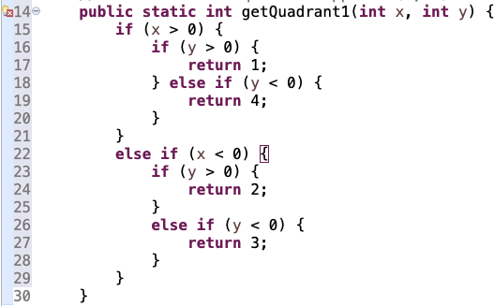
Solution A
What is the logic error?
What is the syntax error?
What would make it easier to read?

Slide 13
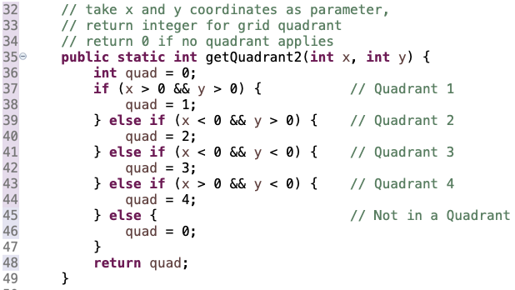
Solution B

Slide 14
4.3
Text Processing
Notes:
Session Title: Project Based Learning (PBL) for Equity in CS classes
Session Description: If you are teaching a survey course like Computer Science Principles, or a code intensive course like AP CS A, PBL can serve as a powerful tool to increase student interest and engagement. Learn about research that connects PBL to improved student outcomes, especially for girls and underrepresented minorities. Discover available PBL resources and understand PBL lesson components, so you can build your own.

Slide 15
Char Primitive Type
char : A primitive type representing single characters.
A String is stored internally as an array of char
String str = "Ali G.";
It is legal to have variables, parameters, returns of type char.
Surround literals with apostrophes: 'a' or '4' or '\n' or '\''
char letter = str.charAt(0); // output:
System.out.println(letter); // A
for (int i = 0; i < str.length(); i++) {
letter = str.charAt(i);
System.out.println(letter); // Ali G.
}
index | 0 | 1 | 2 | 3 | 4 | 5
value | 'A' | 'l' | 'i' | ' ' | 'G' | '.'

Slide 16
Comparing Char Values
You can compare chars with ==, !=, and other operators:
String word = console.next();
char last = word.charAt(word.length() - 1);
if (last == 's') {
System.out.println(word + " is plural.");
}
Characters can be converted to ints.
char ch = ‘a’; // Output
System.out.println((int)ch); // 97

Slide 17
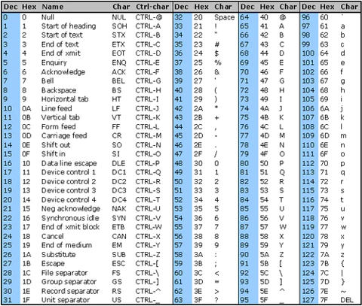
ASCII Table
Notes:
NOTES: 1 and 2 are redundant
what is 3 about?

Slide 18
Demo
Demo5() and Demo6()
Working with Characters

Slide 19
char vs. int
Each char is mapped to an integer value internally
Called an ASCII value
'A' is 65 'B' is 66 ' ' is 32
'a' is 97 'b' is 98 '*' is 42
Mixing char and int causes automatic conversion to int.
'a' + 10 is 107, 'A' + 'A' is 130
To convert an int into the equivalent char, type-cast it.
(char) ('a' + 2) is 'c'
Mixing char and String causes automatic conversion to String.
‘a’ + “pple” = “apple” ““ + ‘J’ = “J”

Slide 20
char vs. String
"h" is a String, but 'h' is a char (they are different)
A String is an object; it contains methods.
String s = "h";
s = s.toUpperCase(); // "H"
int len = s.length(); // 1
char first = s.charAt(0); // 'H'
A char is primitive; you can't call methods on it.
char c = 'h';
c = c.toUpperCase(); // ERROR
s = s.charAt(0).toUpperCase(); // ERROR
What is s + 1 ?
What is c + 1 ?
What is s + s ?
What is c + c ?
“h1”
105
“hh”
208

Slide 21
demo3a()
Working with columns of text
printf()
If you wanted columns, what would Java need to know?
Demo

Slide 22
Formatting with printf
Output with println Output with printf
No worries. Only three types of formatting:
Width (to make columns)
Right or left-justified (default is right justified)
Number of decimal places for doubles
Notes:
NOTES: 1 and 2 are redundant
what is 3 about?

Slide 23
Formatting with printf()
System.out.printf("format string", parameters);
A format string can contain placeholders to insert parameters:
%d decimal integer (base 10)
%f real number (double)
%s string
Example:
int x = 3;
int y = -17;
System.out.printf("x is %d and y is %d!\n", x, y);
// x is 3 and y is -17!
printf does not drop to the next line unless you write \n

Slide 24
Making Columns with printf()
%Wd integer, W characters wide, right-aligned
%-Wd integer, W characters wide, left-aligned
%Wf real number, W characters wide, right-aligned
...
for (int i = 1; i <= 3; i++) {
for (int j = 1; j <= 10; j++) {
System.out.printf("%4d", (i * j));
}
System.out.println(); // to end the line
}
Output:
1 2 3 4 5 6 7 8 9 10
2 4 6 8 10 12 14 16 18 20
3 6 9 12 15 18 21 24 27 30

Slide 25
Defining Precision with printf()
%.Df real number, rounded to D digits after decimal
%W.Df real number, W chars wide, D digits after decimal
%-W.Df real number, W wide (left-align), D after decimal
double gpa = 3.253764;
System.out.printf("your GPA is %.1f\n", gpa);
System.out.printf("more precisely: %8.3f\n", gpa);
Output:
your GPA is 3.3
more precisely: 3.254
1
3
8

Slide 26
demo3b()
Working with columns of text
printf()
Demo

Slide 27
Remember
You Belong Here
This is the week you start new study habits.
27

Slide 28
UT NEWS
Bits and BItes with VISA tmrw at 2pm in room GDC 2.100. Join VISA for an afternoon treat and network with VISA employees

Slide 29
Pattern - Loop Accumulator
An accumulator can be int, double or String, and is typically initialized to 0, 0.0 or “”.
The right side of an assignment is evaluated first, then placed in the variable on the left side.
sum on the left side of an assignment means this is where the new value will be stored.
sum on the right side of an assignment is a reference to the current value of the variable.
put 0 in sum 2. evaluate right side of assignment 3. put result of right side into variable on left
previous contents of this variable are deleted
0 + 7 = 7
sum | 0
sum | 0
sum | 7

